Slide 1
DATABASES

Slide 2
Agenda
Databases and Database Systems
Record Storage
Multi User Access
Memory Management
Data Models and Schemas
Physical Data Independence
Logical Data Independence

Slide 3
What is a Database?
A database is a collection of data stored on a computer
Data in a database is organized into records
Records are of a certain type
Example of various types of records stored in a database:
Employee records
Student records
Medical records

Slide 4
Example University Database
Consider database containing 5 types of records
Type Data
students id, name, grad_year, major_id
departments did, name
courses cid, title, department_id
sections scid, course_id, prof, year_offered
enrollments eid, student_id, section_id, grade

Slide 5
students
sid | name | grad_year | major_id
1 | joe | 2004 | 10
2 | amy | 2004 | 20
3 | max | 2005 | 10
4 | sue | 2005 | 20
5 | bob | 2003 | 30
6 | kim | 2001 | 20
7 | art | 2004 | 30
8 | pat | 2001 | 20
9 | lee | 2004 | 10
departments
did | name
10 | computer science
20 | math
30 | drama
enrollments
eid | student_id | section_id | grade
14 | 1 | 13 | A
24 | 1 | 43 | C
34 | 2 | 43 | B+
44 | 4 | 33 | B
54 | 4 | 53 | B
64 | 6 | 53 | A
courses
cid | title | department_id
12 | db systems | 10
22 | compilers | 10
32 | calculus | 20
42 | algebra | 20
52 | acting | 30
62 | elocution | 30
sections
scid | course_id | profersson | year_offered
13 | 12 | turing | 2004
23 | 12 | turing | 2005
33 | 32 | newton | 2000
43 | 32 | einstein | 2001
53 | 62 | brando | 2001

Slide 6
University Database
Each student described by several records of various types
There is a student record for each student instance
There are several enroll records for each course a student has taken
Each course has course record and several section records
Deciding structure of database is referred to as designing the database

Slide 7
Database Systems Characteristics
Database system: software that manages records of a database
Persistent even after the computer is shut down
Large
Shared among several concurrent users
Accurate and consistent data. Represents reality
Usable allowing easy access and manipulation of data
Database administrator (DBA)

Slide 8
Record Storage
Consider implementing student records in text file
student: sid, name, grad_year, major_id
1→alice→2012→10→2→bob→2012→20→2 →charlie→2012→20↵
Single file: sequentially, updating and searching takes too long
Several auxiliary files per record type
Index file: auxiliary file allows searching data file efficiently

Slide 9
Multi User Access
Several users need to be able to access the database at the same time
Could be accessing / updating same data files
Risk of inconsistency

Slide 10
Inconsistency Risk
Consider database that keeps track of airplane seats
Two users see 40 seats left
One books and seats update from 40 to 39
Other user also updates from 40 to 39 seats
Although 2 seats have been booked, database only records 1 seat
Database is in an inconsistent state

Slide 11
Concurrency Management...
Databases can limit concurrency by blocking or serializing access / update to data records
If one user is reading / updating a record, other users can be blocked until the first one finishes
That way the second user works with a consistent database

Slide 12
Concurrency Management
Databases must detect when actions from various users conflict with one another
Blocking user action must be limited to avoid conflicting actions that would leave the database in an inconsistent state

Slide 13
Transactional Updates
Database updates need to be undoable
Consider a user reserving available hotels & flights
While completing flights, hotels become unavailable
The user needs to undo flights and try other dates

Slide 14
Transactional Updates
While both flights and hotels are not committed, updates should not be visible to other users
Otherwise other users will make decisions on data that is not yet "real"
Committed changes are then visible to other users

Slide 15
Authentication and Authorization
Databases must be able to authenticate users that can access the database through some username / password login mechanism
Users should only be allowed to access / update data to which they have privileges
Users may be allowed to perform only certain types of operations, e.g., read, but not update

Slide 16
Memory Management...
RAM access is 1000 times faster than flash memory, and 100,000 times faster than disk access
Database systems use caching techniques to manage data larger than RAM, while providing reasonable response times
Current data in use is maintained in RAM as long as possible

Slide 17
Memory Management
All access and updates are done in RAM and is kept synchronized with persisted store disk
Risk of inconsistency, outdated data
Must survive system crash

Slide 18
Data Models and Schemas
A data model describes the structure of the data
A schema is the structure of a database
There can be various types of data models including
file-system data model
relational data model

Slide 19
Data Models and Schemas
File-system data model describes the structure of the database (schema) in terms of several files and records encoded in a particular format
Relational data model describes the schema in terms of tables, records, and relationships between the records

Slide 20
Physical Model
The file-system data model is referred to as a physical model
Describes how structure is implemented, e.g.:
Student records stored in students.csv
One record per line
Four fields per record
Field values separated by commas
Software that accesses / updates records need to
read / write file
decode / encode records and fields into file

Slide 21
public static List<String> get1997Students() {
List<String> result=newArrayList<String>();
FileReader rdr=new FileReader("students.csv");
BufferedReader br = new BufferedReader(rdr);
String line = br.readLine();
while (line != null) {
String[] vals = line.split(",");
String gradyear = vals[2];
if (gradyear.equals("1997"))
result.add(vals[1]);
}
line = br.readLine();
return result;
}

Slide 22
Conceptual Model
Relational data model is a conceptual model
The conceptual model
is not concerned with implementation details
uses higher level of abstraction than the physical model
Records are in a students table
Each record contains 4 fields
an integer sid an integer grad_year
a string name an integer major_id
select name from student where grad_year=1997

Slide 23
Other Data Models
Graph-based models treats the database in terms of linked records similar to Class Diagrams
Object-oriented models treats the database as a collection of objects that reference each other and implement object specific behaviors as methods. JPA (Java Persistence Architecture) implements such a model
Hierarchical models treat the database as records that contain sub-records in a tree-like structure of values. XML is an example of such a data model

Slide 24
Physical Data Independence
Conceptual model is easier to work with than physical model
As we work with the conceptual model, database needs to translate to physical model and back
Database catalog describes conceptual and physical schemas
Physical data independence allows users to ignore implementation details and has advantages:
ease of use, query optimization, isolation from physical schema changes

Slide 25
Logical Data Independence...
Different users want to use database in different ways, creating queries specific to their needs
Users might prefer different schemas for convenience
Perhaps a table that contains all data for students in a single table as oppose to spread over several tables

Slide 26
Logical Data Independence
External schemas allow create personalized tables
Databases that provide all three types of schemas are said to have a three-level architecture
Benefits: customized external schemas, isolation from changes in conceptual schema, better security

Slide 27
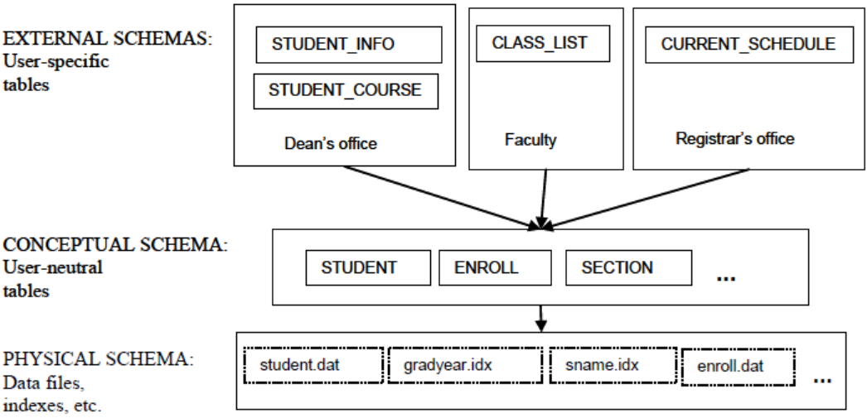
Three-Level Architecture
students
enrollments
sections

